Slide 1
New Restaurant in Bengaluru, India
Coursera DS Capstone Project

Slide 2
Introduction/ Business Problem
Choosing a restaurant site can be quite tricky and the location plays a critical factor in the success of a restaurant. There are multiple variables involved including proximity to entertainment centers, public transport systems, market places, target customers, competing and complimenting restaurants, restaurant density in the area etc.
Also we can gauge the social culture of the city by comparing it to other similar cities. Get to know the preferences of the society in terms of the food they relish. Here, I will try to analyze a major IT hub in India – Bengaluru (earlier Bangalore) and try to answer the below questions -
Comparing neighborhoods of New York and Bengaluru to gauge how similar/dissimilar they are.
Analyzing the locality of Bengaluru to decide which area is more suited to open a new restaurant.

Slide 3
Data Description
List of Neighborhoods in Bangalore - https://en.wikipedia.org/wiki/List_of_neighbourhoods_in_Bangalore
Neighbourhood Names (Total = 63)
Location coordinates for each neighbourhood scraping through their Wikipedia pages iteratively
Neighborhood Names
Latitude
Longitude
Foursquare API to explore all Bengaluru neighbourhoods
Neighborhood Names
Latitude
Longitude
Venues Nearby
Venue Latitude
Venue Longitude
Venue Category

Slide 4
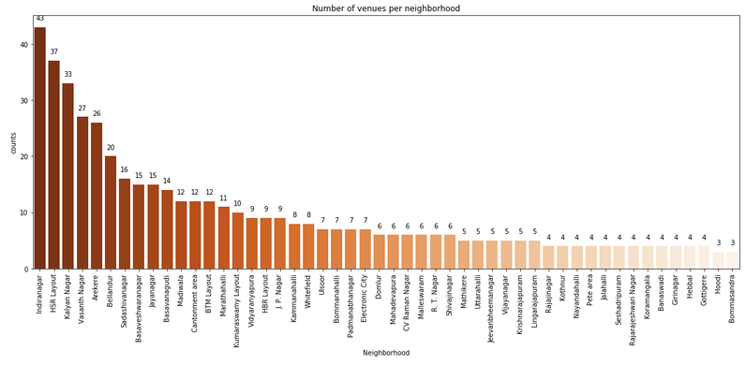
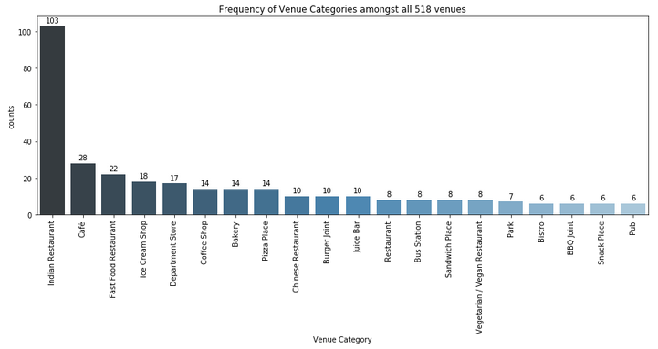
Methodology
Exploratory Analysis –
Machine Learning –
K Means clustering was performed to identify Bengaluru neighbourhoods which are similar to each other. The clusters were then compared to those of New York (from lab notebook) to gauge the differences between the two cities.

Slide 5
Bengaluru Most Visited Venues
New York Most Visited Venues
Indian Restaurant
Café Shops
Department Store
Pizza Place
Desert Shop
Fast food restaurant
Bakery
Coffee shop
Cocktail bar
Park
Italian Restaurant
Yoga Studio
Gym
French Restaurant

Slide 6
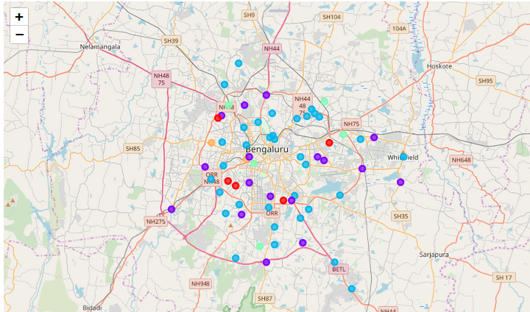
Results
63 neighborhoods were grouped into 5 clusters
Cluster 2 (Deep Green) lies on the outer ring road periphery of Bengaluru. It depicts the new Bengaluru areas which do contain many Indian restaurants but have considerable higher %age of Café, Ice Cream shops and Pizza places compared to other clusters.
Cluster 0 (Red) is concentrated towards the West/South West Bengaluru. It depicts the old Bengaluru areas and are high on Indian restaurants mainly, followed by Fast food and Bakery shops.
Cluster 1 (Violet) is distributed all over Bengaluru.
Cluster 3 (Light Green) and Cluster 4 (Yellow) are very small.

Slide 7
Discussion
Observations –
As can be seen, the cities of Bengaluru and New York (lab notebook) are quite different. The most common venues in Bengaluru includes - Indian Restaurant, Cafe Shops, Department Stores, Pizza place, Desert shop, Fast food restaurants, and Bakery.
Whereas, in New York, the most visited places are - Coffee shop, Cocktail bar, Park, Italian restaurant, Yoga studio, Gym and French Restaurant.
Recommendations –
Hence, in case of restaurants, it makes sense to open either 'Indian Restaurant' or 'Pizza Place' or ‘Cafe Shop' in Bengaluru, India.
Lets assume that the restaurant to be opened is a 'Pizza Place'. Hence, further location analysis is required to decide the neighbourhood.

Slide 8
Conclusion
Amongst neighbourhoods - Domlur, CV Raman Nagar, Vidyaranyapura, BTM Layout, Arekere - are the locations wherein 'Pizza Place' is amongst the top 3 most common venue. Out of these 5 places, only CV Raman Nagar and BTM Layout are located nearby metro stations.
BTM Layout seems a better choice compared to CV Raman Nagar because of two other factors. First, BTM layout is more popular commercial and residential area of Bangalore. Second, as can be inferred from the most common venues list, more restaurants are visited in BTM layout (in the top 10 venues) compared to CV Raman Nagar.
Hence, the final choice of neighbourhood for opening a Pizza restaurant should be 'BTM Layout'.

